Slide 1
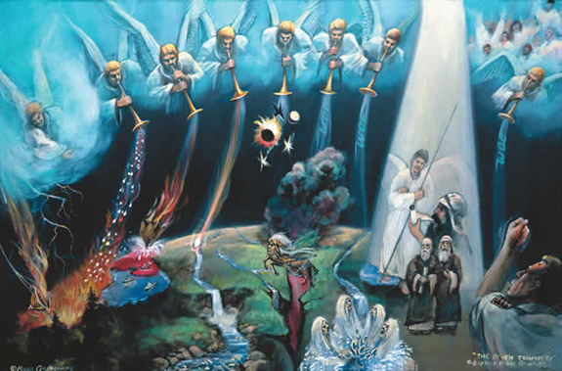
The Grace Witnesses
(Rev. 10–11)
Rick Griffith • Crossroads International Church • BibleStudyDownloads.org

Slide 2

Left Behind

Slide 3
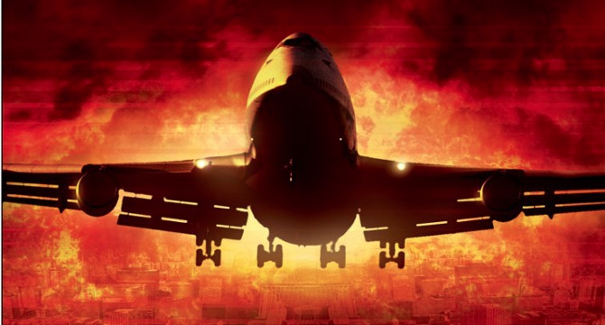
Grace Means Not Being Left Behind

Slide 4
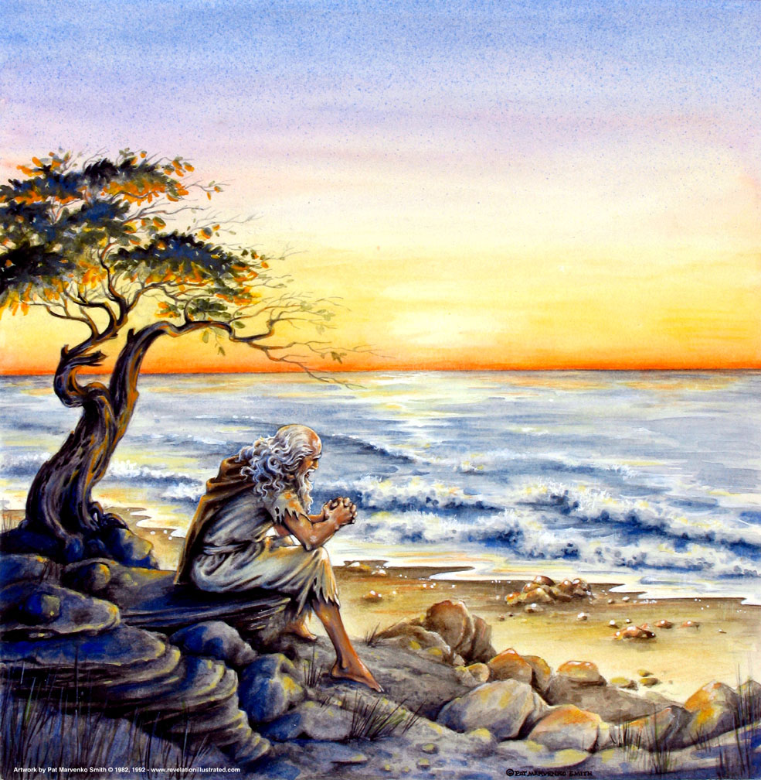
John at Patmos (1:9)
319

Slide 5
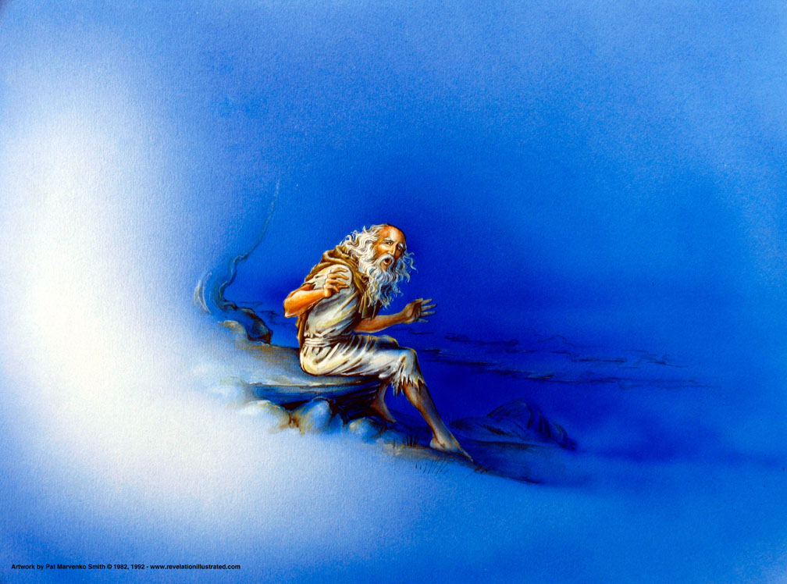
John Turning (1:12)

Slide 6
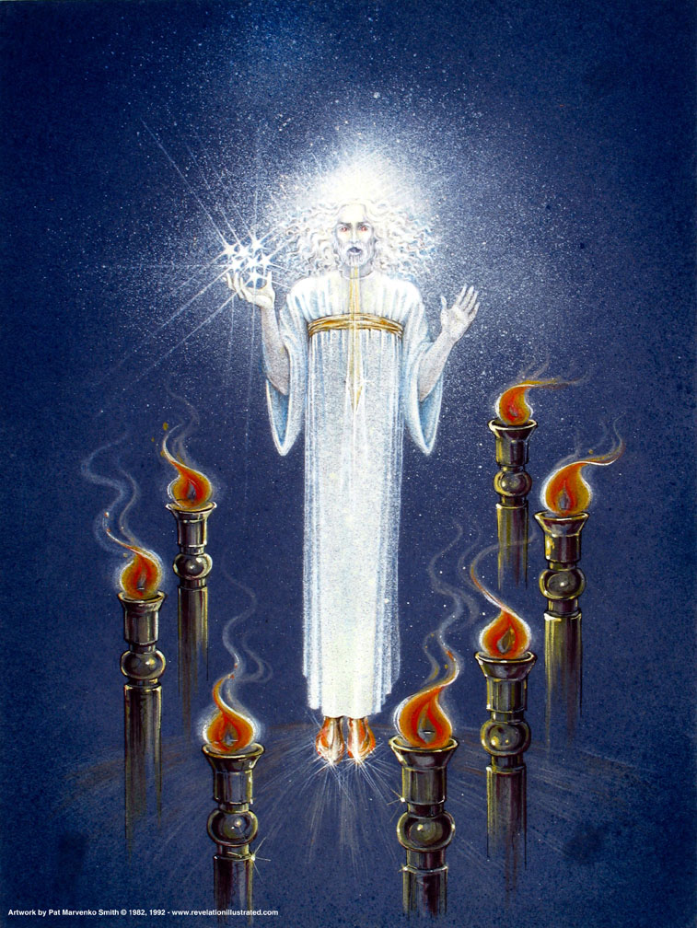
Christ Among the Lamp Stands
(1:12-16)

Slide 7
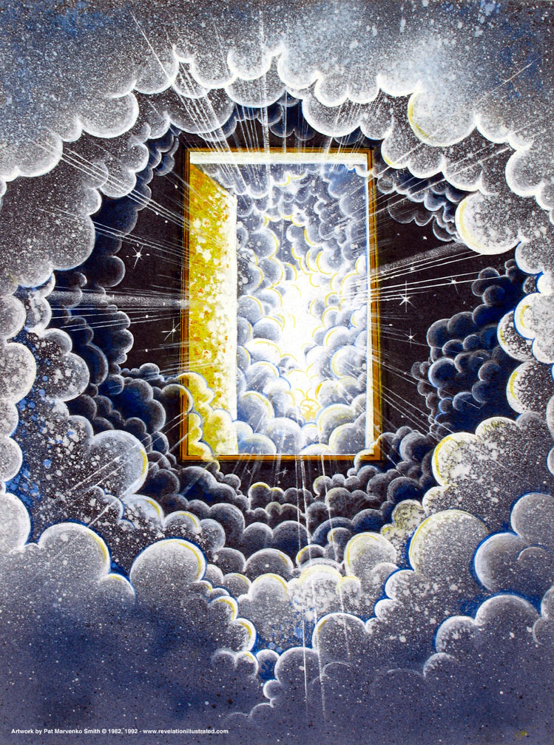
"I saw a door opened…" (4:1)

Slide 8
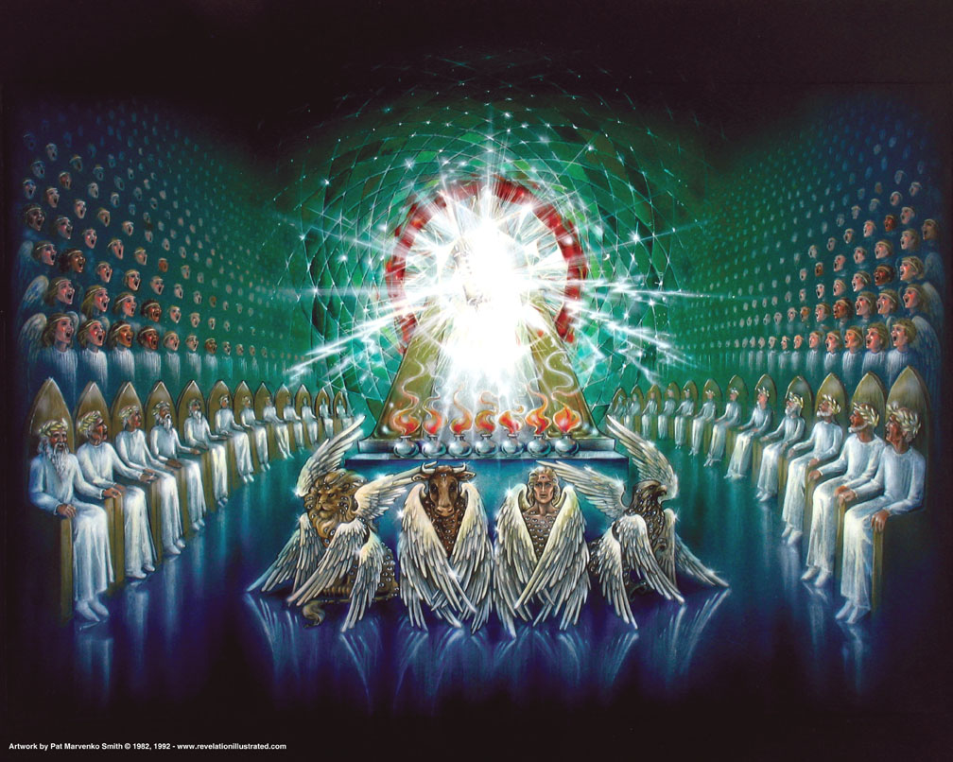
The Four Living Creatures (4:6)

Slide 9
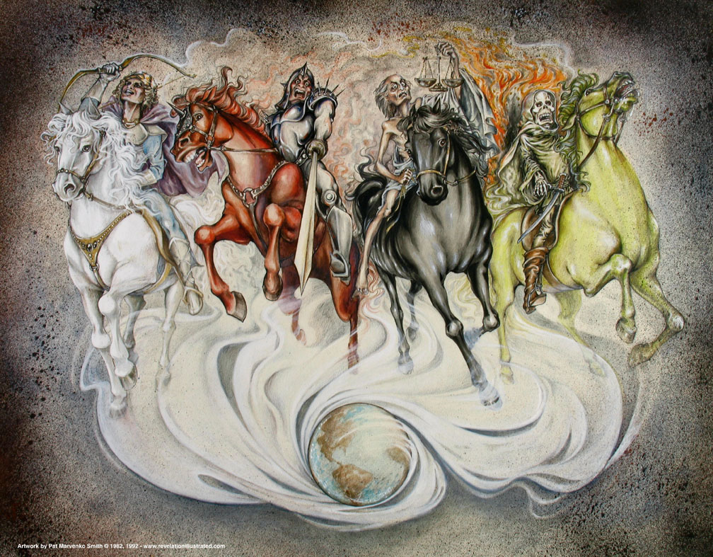
The Seals (Rev. 6)

Slide 10
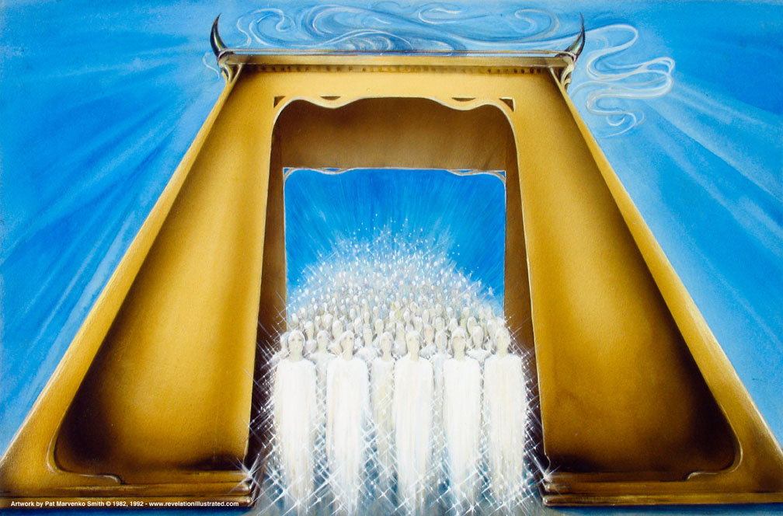
Seal #5: Martyrs Assured under the Altar (6:9-11)
376
Used with permission

Slide 11
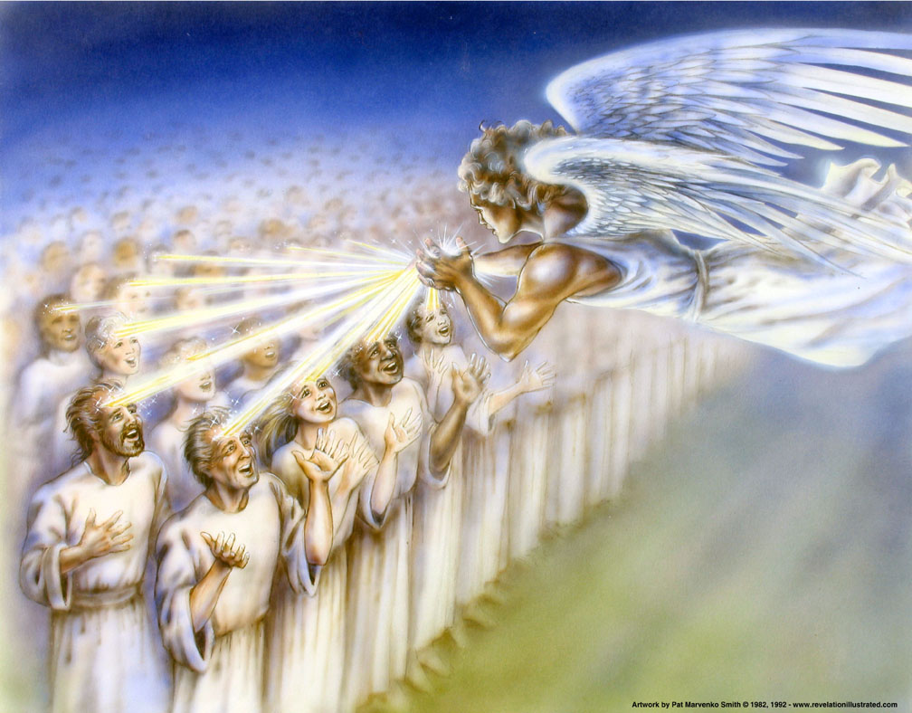
144,000 Jews Sealed (7:3)

Slide 12
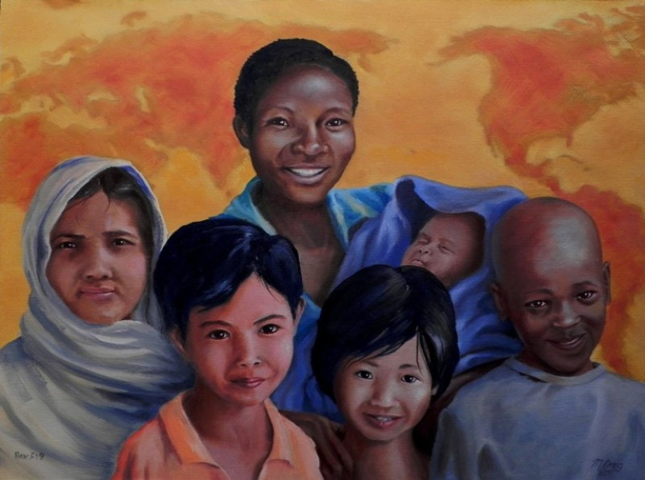
Redeemed "from every tribe, nation, language and people" (5:9; 7:9)

Slide 13

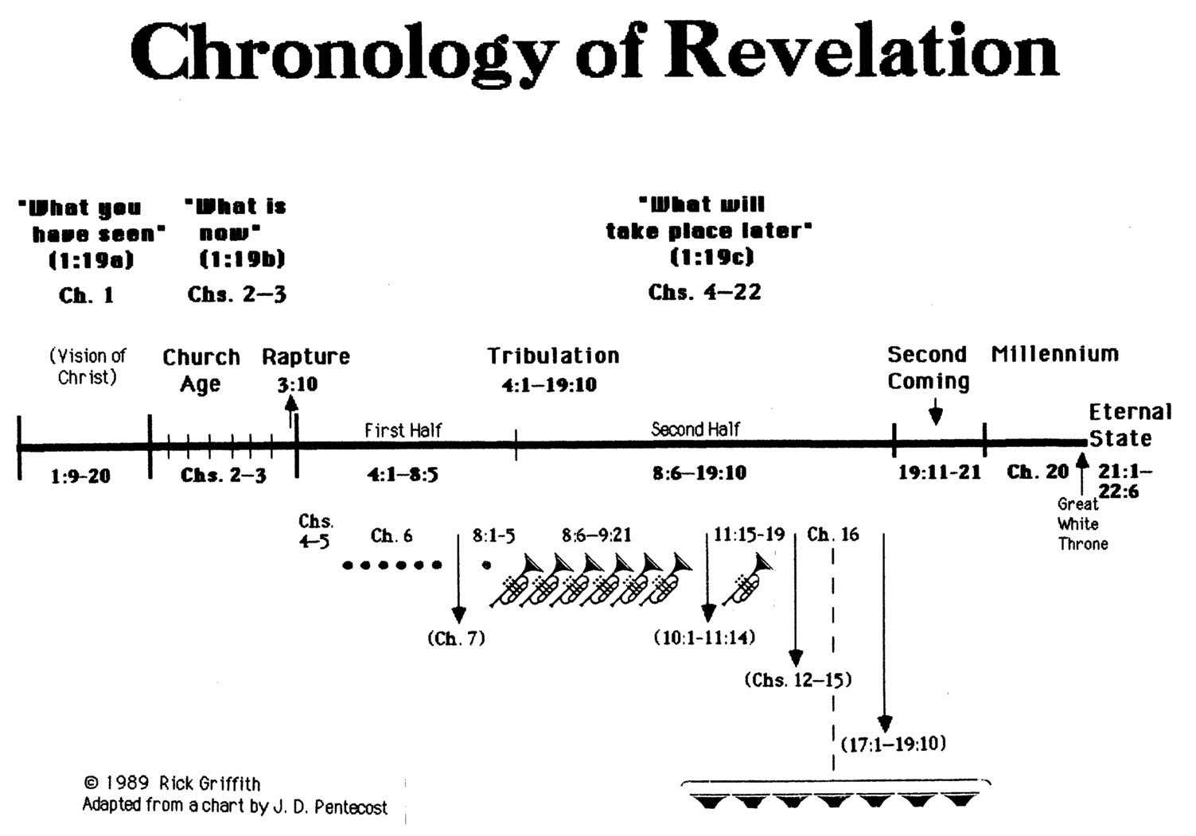
Chronology of Revelation
340
"What you have seen"
(1:19a)
Rev. 1
"What is
now"
(1:19b)
Rev. 2–3
"What will
take place later"
(1:19c)
Rev. 4–22
Vision of Christ
Church
Age
Rapture
3:10
Tribulation
4:1 – 19:10
Second Coming
Millennium
First Half
Second Half
Eternal State
Great White Throne Judgment
Copyright 1989 Rick Griffith
Adapted from a chart by J. D. Pentecost
Notes:
The 3 main divisions of Revelation are summarized in 1:19
The 3 main cycles of judgment are squared in blue
The 4 parenthetical sections appear in parentheses within the scrolls. They do not advance the chronology but add important information that is not associated with a particular judgment.

Slide 14
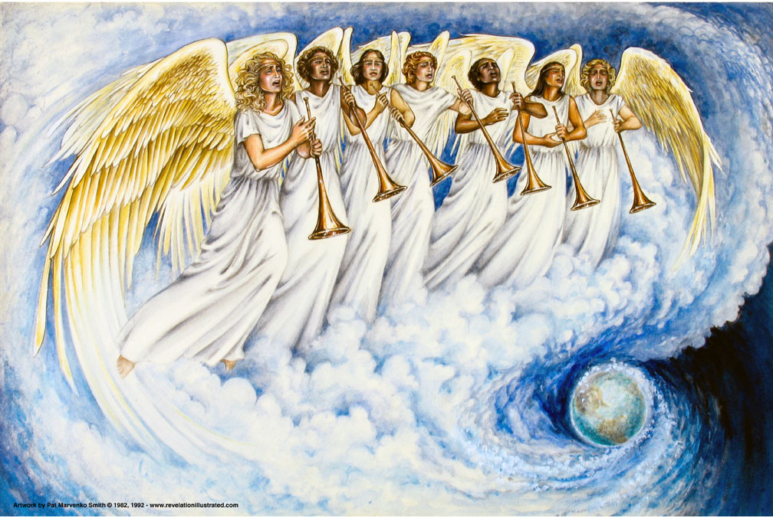
Seven Trumpet Judgments (8:6–11:19)
381
Used with permission

Slide 15
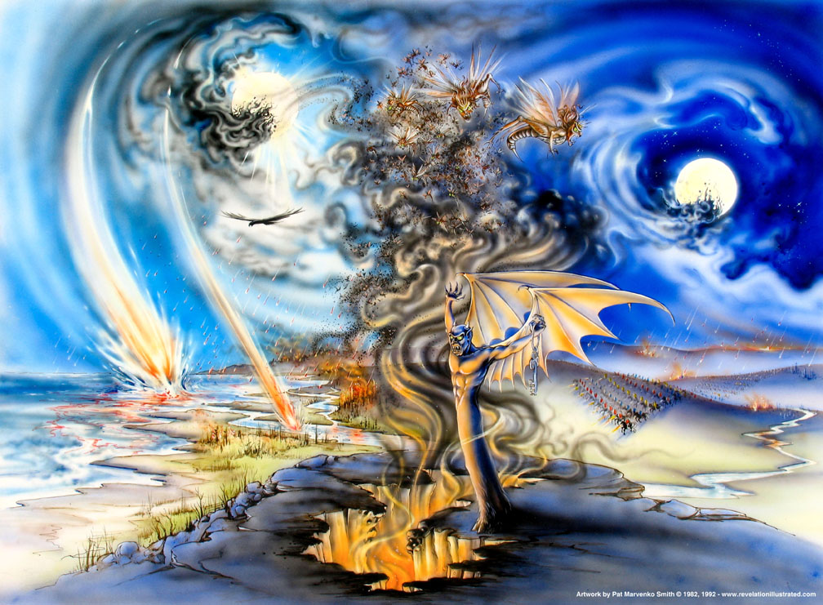
Trumpet Judgments (Rev. 8–9)
Used with permission

Slide 16
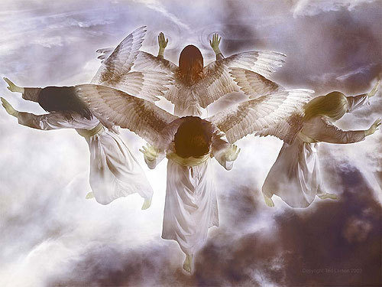
Angels will still minister God's grace!

Slide 17
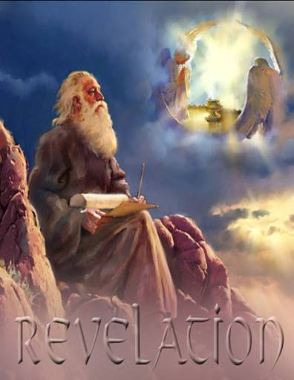
"Unveiling"
381
How do you see Christ's grace to you right now?

Slide 18

Three evidences of…
(
)
10–11 Witnesses
12
Satan
13–14
Henchmen

Slide 19
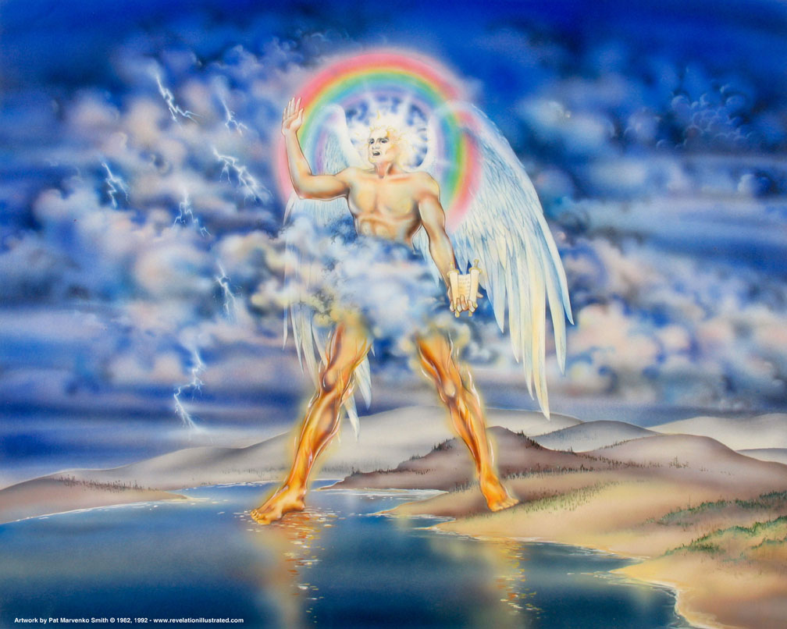
I. Jesus will show God's Word has opposite affects for believers and unbelievers (Rev. 10).
Notes:
"The fact that the angel's face is "as the sun" corresponds to the description of Jesus Christ in Revelation 1:16; his feet correspond to the Lord's description in Revelation 1:15. His voice like a lion suggests Revelation 5:5. This being could well be our Lord Jesus Christ, appearing to John as a kingly angel. Jesus often appeared in the Old Testament as "the Angel of the Lord" (Ex. 3:2; Jud. 2:4; 6:11–12, 21–22; 2 Sam. 24:16). This was a temporary manifestation for a special purpose, not a permanent incarnation.
Two other characteristics would suggest identifying the angel as Jesus Christ: the book in his hand and the awesome posture that he assumed. The little book contains the rest of the prophetic message that John will deliver. Since our Lord was the only One worthy to take the scroll and break the seals (Rev. 5:5ff), it might well be concluded that He is the only One worthy to give His servant the rest of the message.
The angel's posture is that of a conqueror taking possession of his territory. He is claiming the whole world (see Josh. 1:1–3). Of course, only the victorious Savior could make such a claim. The Antichrist will soon complete his conquest and force the whole world to submit to his control. But before that happens, the Savior will claim the world for Himself, the inheritance that His Father promised Him (Ps. 2:6–9). Satan roars like a lion to frighten his prey (1 Peter 5:8), but the Lion of Judah roars to announce victory (see Ps. 95:3–5; Isa. 40:12–17)" (Wiersbe).

Slide 20
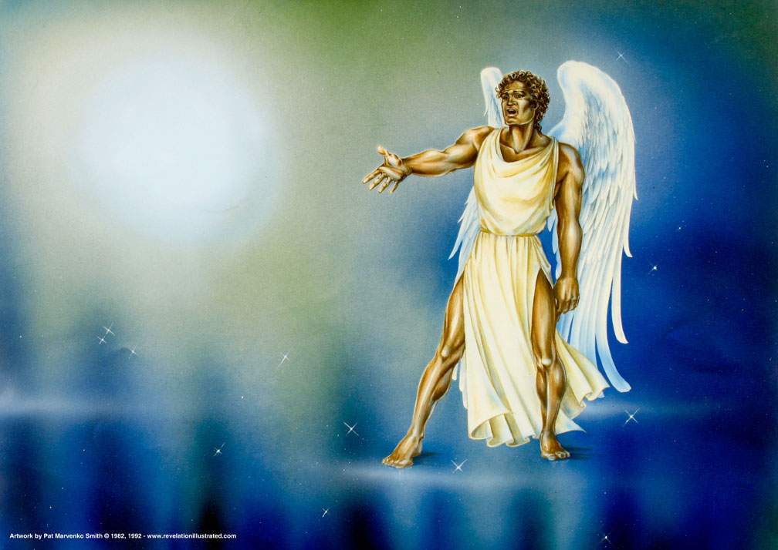
Another Mighty Angel (5:2)
"Who is worthy to break the seals and open the scroll?"

Slide 21
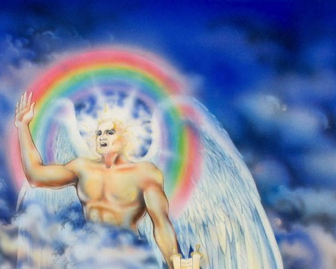
"Then I saw another mighty angel coming down from heaven, surrounded by a cloud, with a rainbow over his head. His face shone like the sun, and his feet were like pillars of fire"
(10:1 NLT)
Notes:
"The fact that the angel's face is "as the sun" corresponds to the description of Jesus Christ in Revelation 1:16; his feet correspond to the Lord's description in Revelation 1:15. His voice like a lion suggests Revelation 5:5. This being could well be our Lord Jesus Christ, appearing to John as a kingly angel. Jesus often appeared in the Old Testament as "the Angel of the Lord" (Ex. 3:2; Jud. 2:4; 6:11–12, 21–22; 2 Sam. 24:16). This was a temporary manifestation for a special purpose, not a permanent incarnation.
Two other characteristics would suggest identifying the angel as Jesus Christ: the book in his hand and the awesome posture that he assumed. The little book contains the rest of the prophetic message that John will deliver. Since our Lord was the only One worthy to take the scroll and break the seals (Rev. 5:5ff), it might well be concluded that He is the only One worthy to give His servant the rest of the message.
The angel's posture is that of a conqueror taking possession of his territory. He is claiming the whole world (see Josh. 1:1–3). Of course, only the victorious Savior could make such a claim. The Antichrist will soon complete his conquest and force the whole world to submit to his control. But before that happens, the Savior will claim the world for Himself, the inheritance that His Father promised Him (Ps. 2:6–9). Satan roars like a lion to frighten his prey (1 Peter 5:8), but the Lion of Judah roars to announce victory (see Ps. 95:3–5; Isa. 40:12–17)" (Wiersbe).

Slide 22
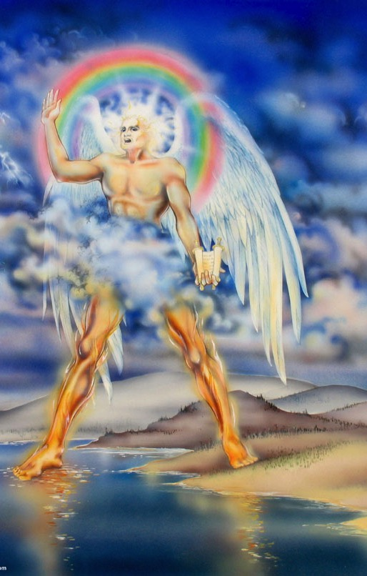
"And in his hand was a small scroll that had been opened. He stood with his right foot on the sea and his left foot on the land. ³And he gave a great shout like the roar of a lion. And when he shouted, the seven thunders answered"
(10:2-3 NLT).
Notes:
"The fact that the angel's face is "as the sun" corresponds to the description of Jesus Christ in Revelation 1:16; his feet correspond to the Lord's description in Revelation 1:15. His voice like a lion suggests Revelation 5:5. This being could well be our Lord Jesus Christ, appearing to John as a kingly angel. Jesus often appeared in the Old Testament as "the Angel of the Lord" (Ex. 3:2; Jud. 2:4; 6:11–12, 21–22; 2 Sam. 24:16). This was a temporary manifestation for a special purpose, not a permanent incarnation.
Two other characteristics would suggest identifying the angel as Jesus Christ: the book in his hand and the awesome posture that he assumed. The little book contains the rest of the prophetic message that John will deliver. Since our Lord was the only One worthy to take the scroll and break the seals (Rev. 5:5ff), it might well be concluded that He is the only One worthy to give His servant the rest of the message.
The angel's posture is that of a conqueror taking possession of his territory. He is claiming the whole world (see Josh. 1:1–3). Of course, only the victorious Savior could make such a claim. The Antichrist will soon complete his conquest and force the whole world to submit to his control. But before that happens, the Savior will claim the world for Himself, the inheritance that His Father promised Him (Ps. 2:6–9). Satan roars like a lion to frighten his prey (1 Peter 5:8), but the Lion of Judah roars to announce victory (see Ps. 95:3–5; Isa. 40:12–17)" (Wiersbe).

Slide 23
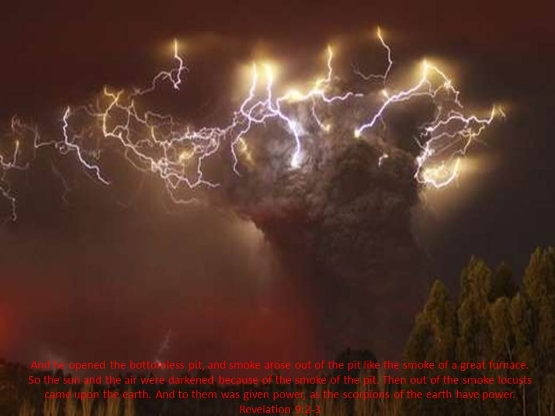
The 7 Thunders (10:4)
382
"When the seven thunders spoke, I was about to write. But I heard a voice from heaven saying, 'Keep secret what the seven thunders said, and do not write it down'" (10:4 NLT)

Slide 24
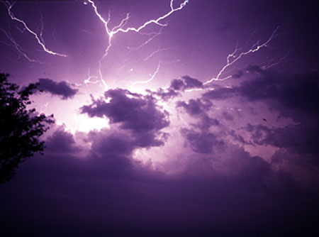
Warning (10:5-7)
382
"Then the angel I saw standing on the sea and on the land raised his right hand toward heaven. ⁶He swore an oath in the name of the one who lives forever and ever, who created the heavens and everything in them, the earth and everything in it, and the sea and everything in it. He said, 'There will be no more delay. ⁷When the seventh angel blows his trumpet, God's mysterious plan will be fulfilled. It will happen just as he announced it to his servants the prophets'" (10:5-7 NLT)

Slide 25

Jesus Wins!
Series on Revelation

Slide 26
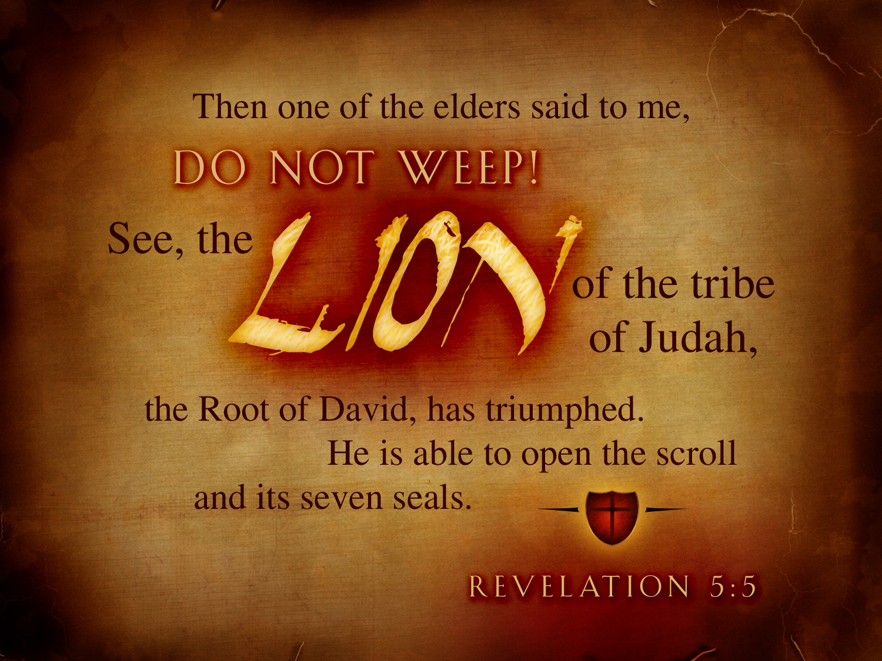
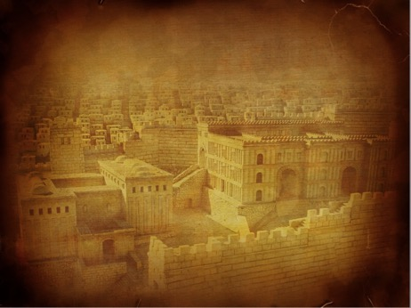
Revelation 5:5
369

Slide 27
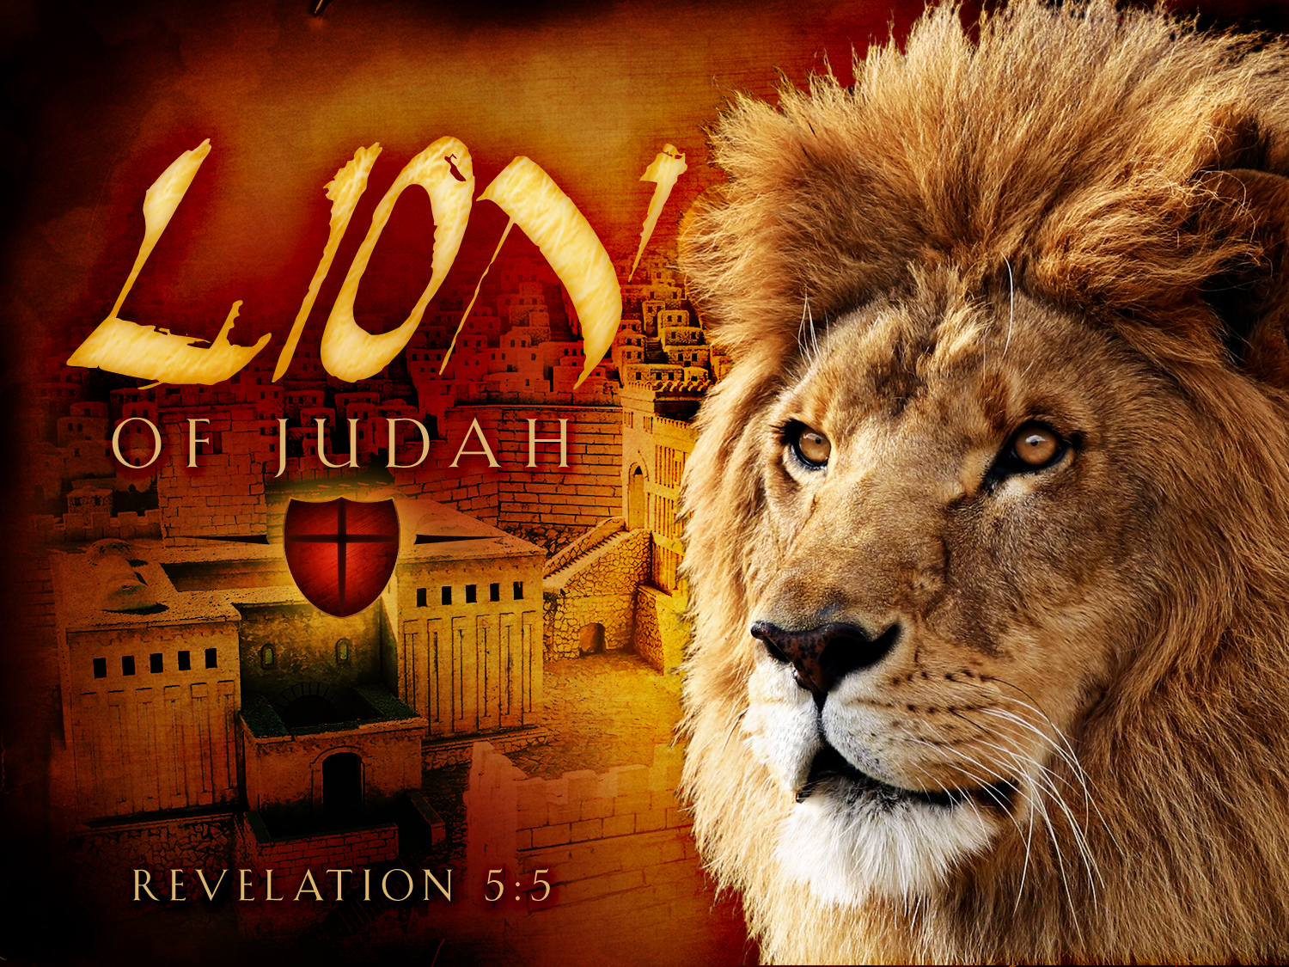
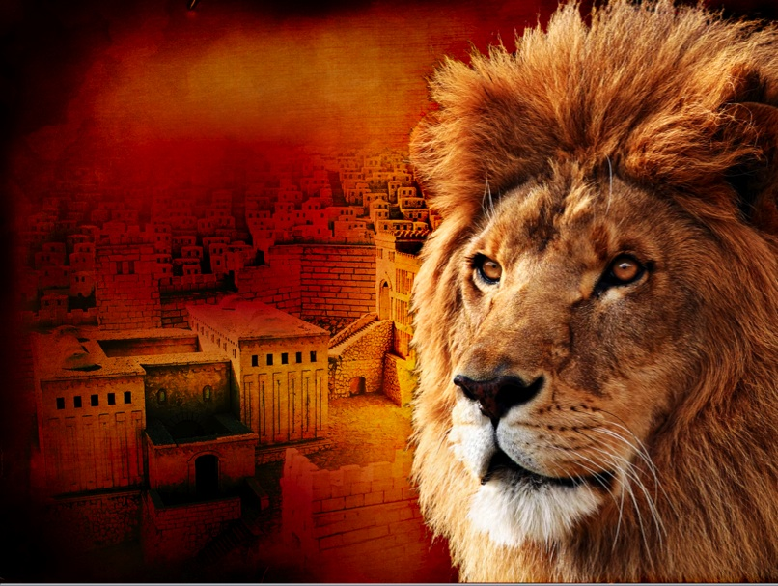
369
LION
OF JUDAH
REVELATION 5:5

Slide 28
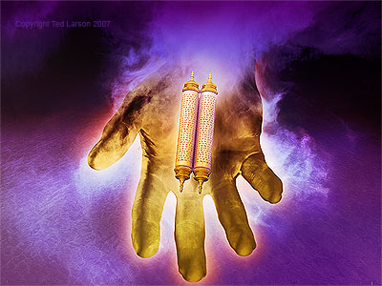
The Little Scroll (10:8-11)
382
"Then the voice from heaven spoke to me again: "Go and take the open scroll from the hand of the angel who is standing on the sea and on the land'"
(10:8 NLT)

Slide 29
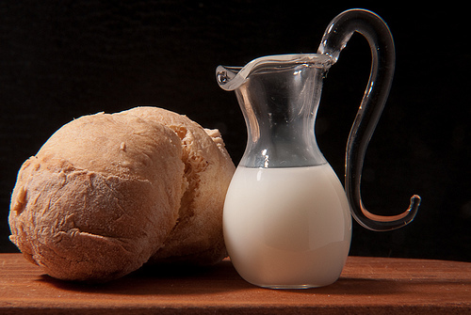
The Bible as bread and milk
382

Slide 30
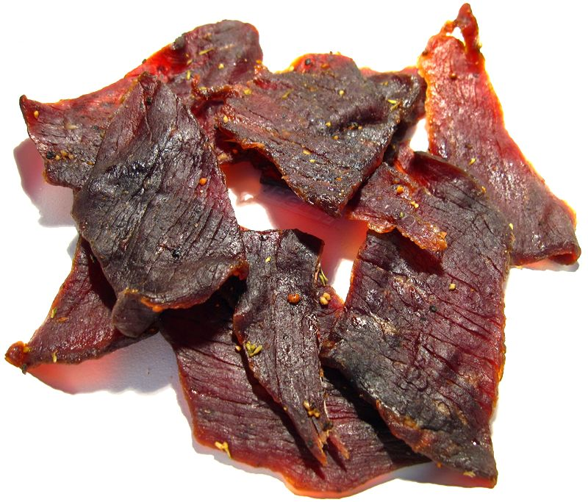
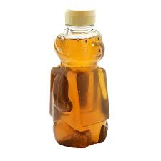
The Bible as meat and honey
382

Slide 31
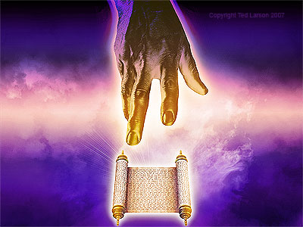
The Little Scroll (10:8)
382
"So I went to the angel and told him to give me the small scroll. 'Yes, take it and eat it,' he said. 'It will be sweet as honey in your mouth, but it will turn sour in your stomach!' ¹⁰So I took the small scroll from the hand of the angel, and I ate it! It was sweet in my mouth, but when I swallowed it, it turned sour in my stomach'" (10:9-10 NLT)

Slide 32
God's Mysterious Plan
382
"When the seventh angel blows his trumpet, God's mysterious plan will be fulfilled. It will happen just as he announced it to his servants the prophets'" (10:7 NLT)

Slide 33
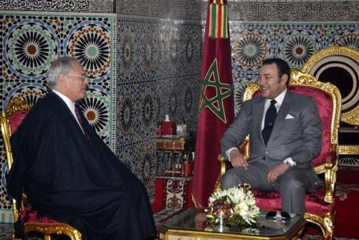
"Prophesy Again"
382
"Then I was told, 'You must prophesy again about many peoples, nations, languages, and kings'" (10:11 NLT)

Slide 34
Redeemed "from every tribe, nation, language and people" (5:9; 7:9)

Slide 35
I. Jesus will show God's Word has opposite affects for believers and unbelievers (Rev. 10).
Notes:
"The fact that the angel's face is "as the sun" corresponds to the description of Jesus Christ in Revelation 1:16; his feet correspond to the Lord's description in Revelation 1:15. His voice like a lion suggests Revelation 5:5. This being could well be our Lord Jesus Christ, appearing to John as a kingly angel. Jesus often appeared in the Old Testament as "the Angel of the Lord" (Ex. 3:2; Jud. 2:4; 6:11–12, 21–22; 2 Sam. 24:16). This was a temporary manifestation for a special purpose, not a permanent incarnation.
Two other characteristics would suggest identifying the angel as Jesus Christ: the book in his hand and the awesome posture that he assumed. The little book contains the rest of the prophetic message that John will deliver. Since our Lord was the only One worthy to take the scroll and break the seals (Rev. 5:5ff), it might well be concluded that He is the only One worthy to give His servant the rest of the message.
The angel's posture is that of a conqueror taking possession of his territory. He is claiming the whole world (see Josh. 1:1–3). Of course, only the victorious Savior could make such a claim. The Antichrist will soon complete his conquest and force the whole world to submit to his control. But before that happens, the Savior will claim the world for Himself, the inheritance that His Father promised Him (Ps. 2:6–9). Satan roars like a lion to frighten his prey (1 Peter 5:8), but the Lion of Judah roars to announce victory (see Ps. 95:3–5; Isa. 40:12–17)" (Wiersbe).

Slide 36
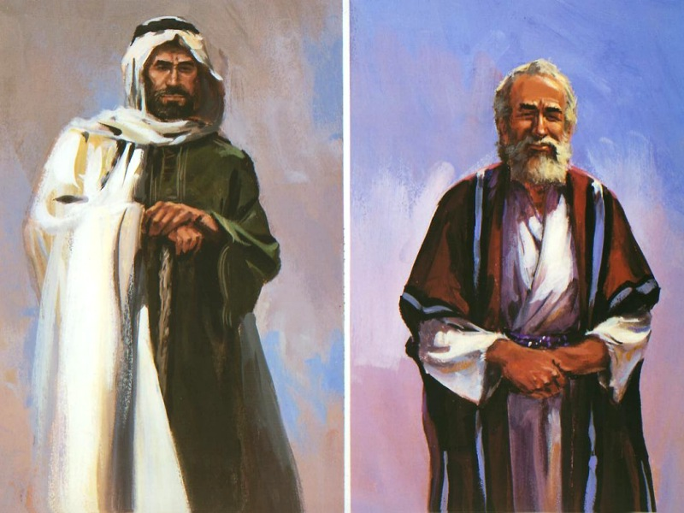
II. Two witnesses will show God's protection for believers and wrath for unbelievers (11:1-14).
383

Slide 37
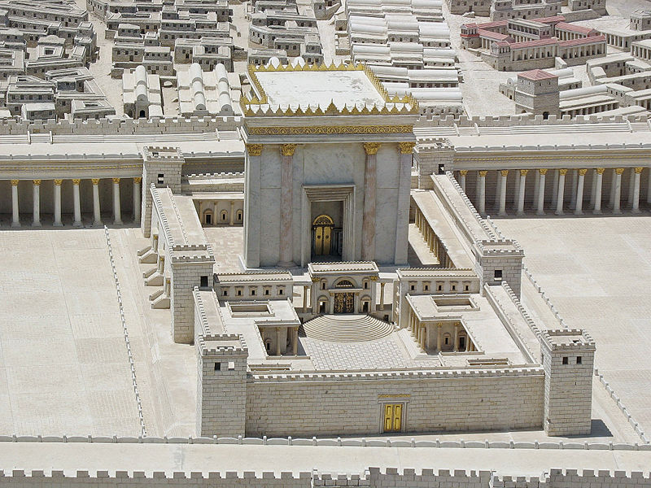
The Temple (11:1-2)
382
"Then I was given a measuring stick, and I was told, 'Go and measure the Temple of God and the altar, and count the number of worshipers. ²But do not measure the outer courtyard, for it has been turned over to the nations. They will trample the holy city for 42 months.'"

Slide 38
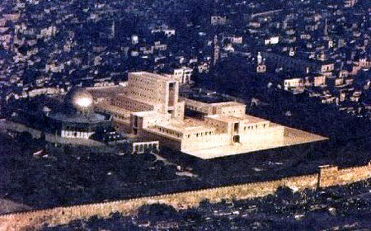
A Rebuilt Temple!
382

Slide 39

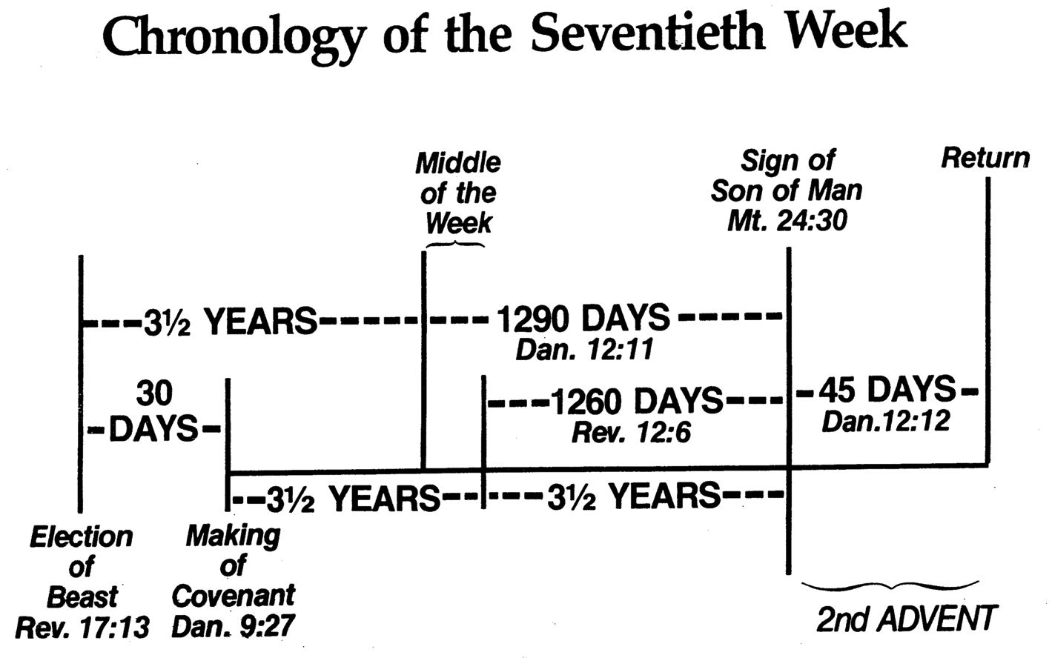
Chronology of the 70th "Week"
333
Adapted from J. Dwight Pentecost, Dallas Theological Seminary, 1988
Middle of the Week
Sign of
Son of Man
Matt. 24:30
Christ's Return Complete
3½ YEARS
1290 DAYS
Dan. 12:11
30 DAYS
30 DAYS
1260 DAYS
45 DAYS
Rev. 11:3; 12:6
Dan. 12:12
3½ YEARS
3½ YEARS
Election
of Beast
Rev. 17:13
Covenant Made
Dan. 9:27a
Covenant Broken
Dan. 9:27b
2nd ADVENT
The Great Tribulation
The Tribulation

Slide 40
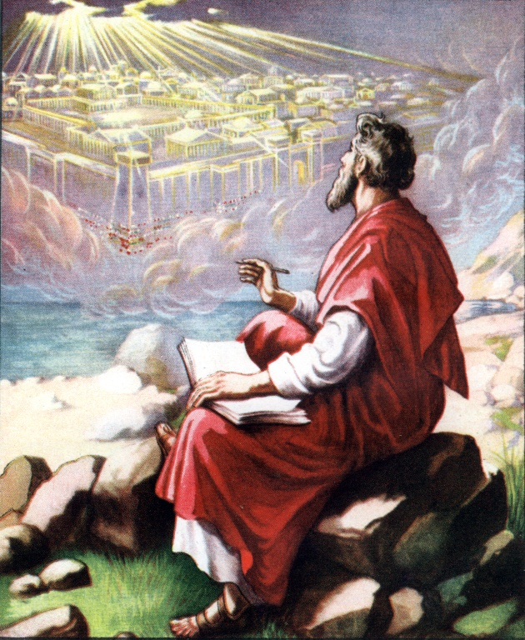
The Temple (11:1-13)
382
Heavenly?
or
Earthly?

Slide 41


Revelation 11
329
Revelation 11
A Test Case in Hermeneutics
I was given a reed like a measuring rod and was told, "Go and measure the temple of God and the altar, and count the worshipers there. But exclude the outer court; do not measure it, because it has been given to the Gentiles. They will trample on the holy city for 42 months. And I will give power to my two witnesses, and they will prophesy for 1,260 days, clothed in sackcloth."

Slide 42

11:1 Measure
329
Revelation 11
Term or Expression | Beale Symbolic | Osborne Symbolic-Literal | Thomas Literal
1 "measure" (11:1) | "the infallible promise of God's future presence"; "the protec-tion of God's eschatologi-cal community"; "until the parousia" | "preservation of the saints spiritually in the coming great persecution"; "a prophetic anticipation of the final victory of the church" | "a mark of God's favor"

Slide 43
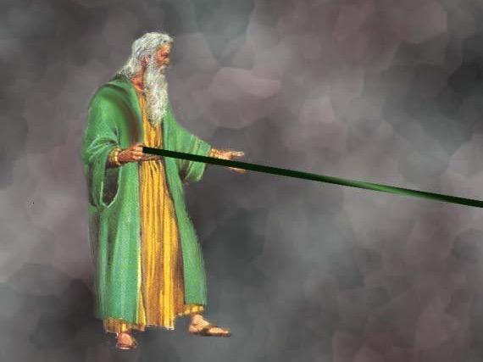
A Measuring Rod for Jerusalem (Zech. 2:1-4 NLT)
When I looked again, I saw a man with a measuring line in his hand. ²"Where are you going?" I asked. He replied, "I am going to measure Jerusalem, to see how wide and how long it is."

Slide 44


11:1 Temple
329
Revelation 11
Term or Expression | Beale Symbolic | Osborne Symbolic-Literal | Thomas Literal
2 "the temple (naon)" (11:1) | "the temple of the church"; "Christians"; "the whole covenant community"; "…believers undergoing persecution yet protected by God" | heavenly temple depicting "the church, primarily the saints of this final period but secondarily the church of all ages" | "a future temple in Jerusalem during the period just before Christ returns"

Slide 45



11:1 Altar
329
Revelation 11
Term or Expression |  | Beale Symbolic | Osborne Symbolic-Literal | Thomas Literal
3 "the altar" (11:1) | "the suffering covenant community" |  | the [heavenly] altar of incense" | "the brazen altar of sacrifice in the court outside the sanctuary"

Slide 46
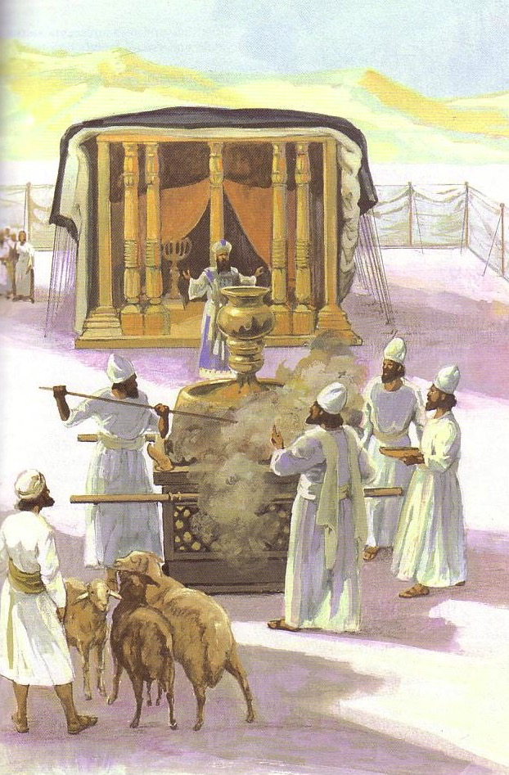
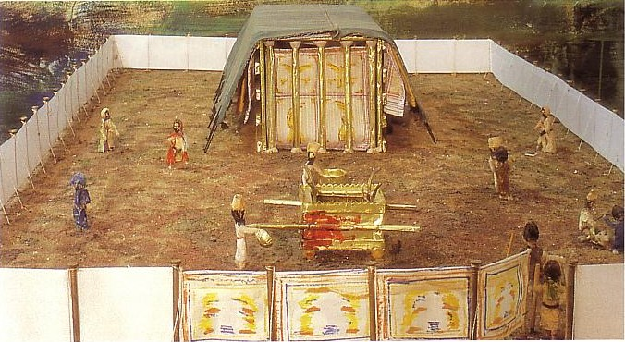
The Tabernacle

Slide 47

Solomon's Temple

Slide 48
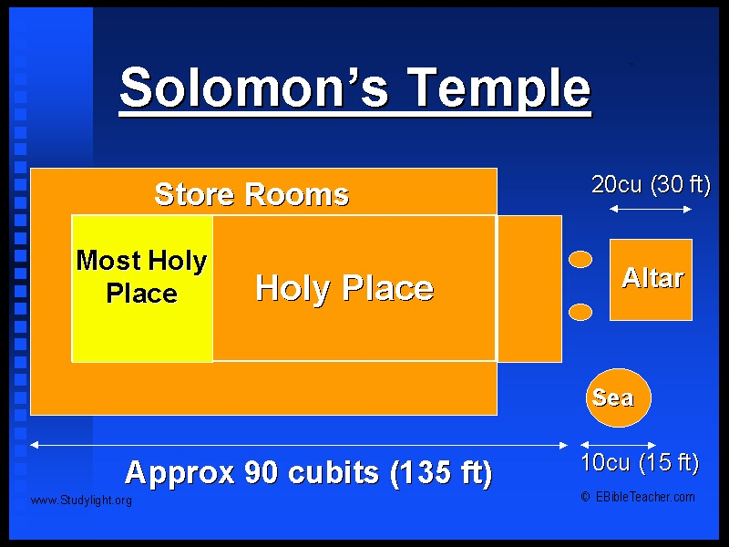
Temple Dimensions

Slide 49



11:2 Gentiles
329
Revelation 11
Term or Expression | Beale Symbolic | Osborne Symbolic-Literal | Thomas Literal
8 "the Gentiles" (11:2) | "the Gentiles and Jews" | "the church handed over to the Gentiles/ nations for a time" | "a group [of non-Jews] in rebellion against God who will oppress the Jewish remnant"

Slide 50

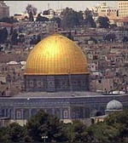
11:2 Holy City
329
Revelation 11
Term or Expression | Beale Symbolic | Osborne Symbolic-Literal | Thomas Literal
10 "the holy city" (11:2) | "the initial form of the heavenly city, part of which is identified with believers living on earth" | "the people of God" | "the literal city of Jerusalem on earth"

Slide 51

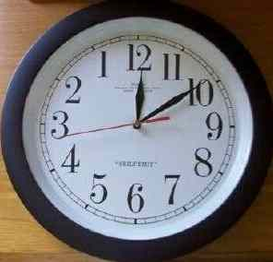
11:2 Forty-Two Months
330
Revelation 11
Term or Expression | Beale Symbolic | Osborne Symbolic-Literal | Thomas Literal
11 "forty-two months" (11:2) | "figurative for the eschatological period of tribulation"; "attack on the community of faith throughout the church age" | "the great tribulation at the end of history" | "the last half of Daniel's seventieth week"

Slide 52
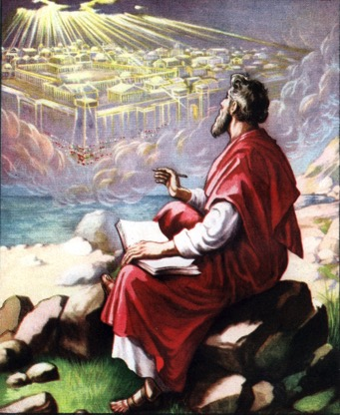
"To spiritualize Revelation 11:1–2 and make the temple refer to the church creates a number of serious problems.
382
For one thing, how could John measure an invisible body of people, even if the church were still on earth?
If the temple is the church, then who are the worshipers and what is the altar?
And since the church unites Jews and Gentiles in one body (Eph. 2:11ff), why are the Gentiles segregated in this temple?
It is best to interpret this temple as an actual building in the holy city of Jerusalem (Neh. 11:1, 18; Dan. 9:24)."
Warren Wiersbe, Bible Exposition Commentary

Slide 53
The Two Witnesses (11:3 NLT)
383
"And I will give power to my two witnesses, and they will be clothed in burlap and will prophesy during those 1,260 days."

Slide 54

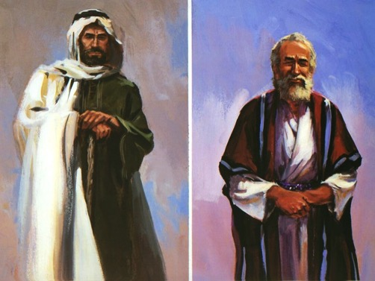
11:3 Two Witnesses
330
Revelation 11
Term or Expression | Beale Symbolic | Osborne Symbolic-Literal | Thomas Literal
12 "the two witnesses" (11:3) | the church; "the whole community of faith" | "two major eschatological figures… as a symbol for the witnessing church" | two future prophets, probably Moses and Elijah

Slide 55
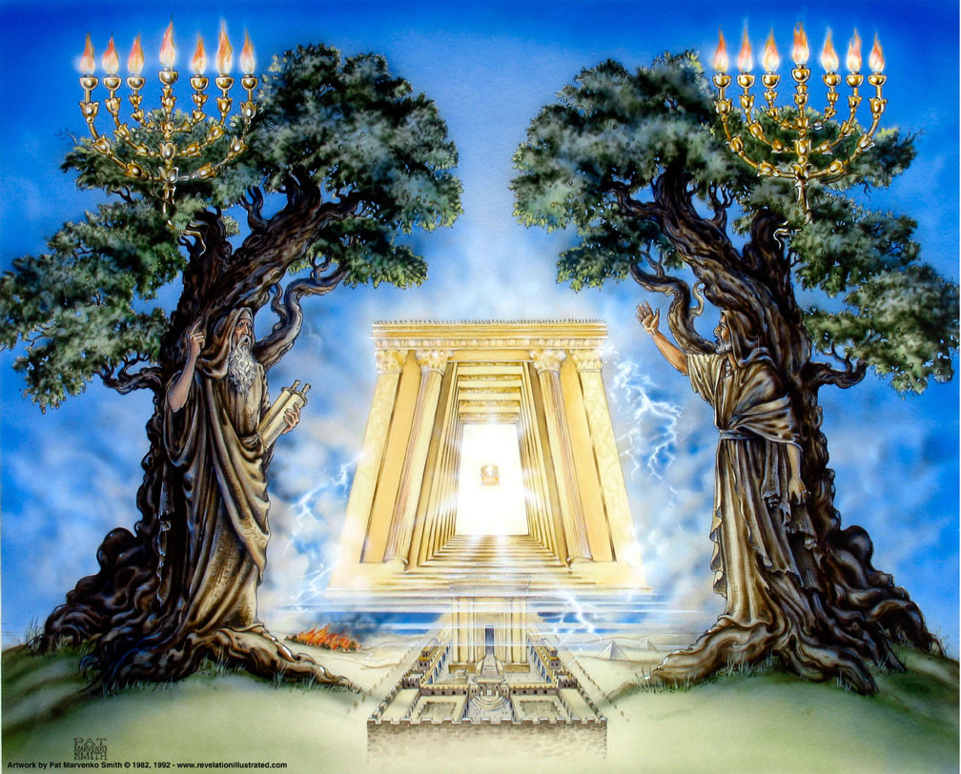
Olive Trees (11:4)

Slide 56
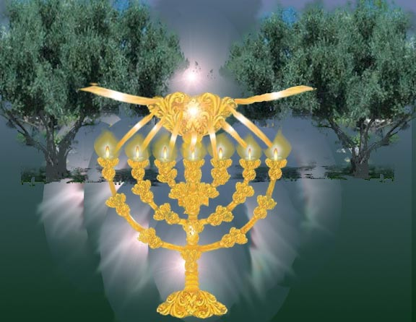
The Lamp & Olive Trees (Zech. 4:1-14)
"'Zerubbabel is the one who laid the foundation of this Temple, and he will complete it. Then you will know that the LORD of Heaven's Armies has sent me. ¹⁰Do not despise these small beginnings, for the LORD rejoices to see the work begin, to see the plumb line in Zerubbabel's hand.' (The seven lamps represent the eyes of the LORD that search all around the world.)" (Zech. 4:9-10 NLT)

Slide 57
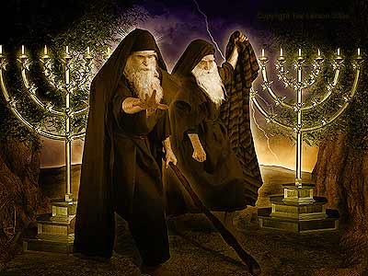
"Don't mess with us!"
330
"These two prophets are the two olive trees and the two lampstands that stand before the Lord of all the earth. ⁵If anyone tries to harm them, fire flashes from their mouths and consumes their enemies. This is how anyone who tries to harm them must die. ⁶They have power to shut the sky so that no rain will fall for as long as they prophesy. And they have the power to turn the rivers and oceans into blood, and to strike the earth with every kind of plague as often as they wish" (11:4-6 NLT).

Slide 58
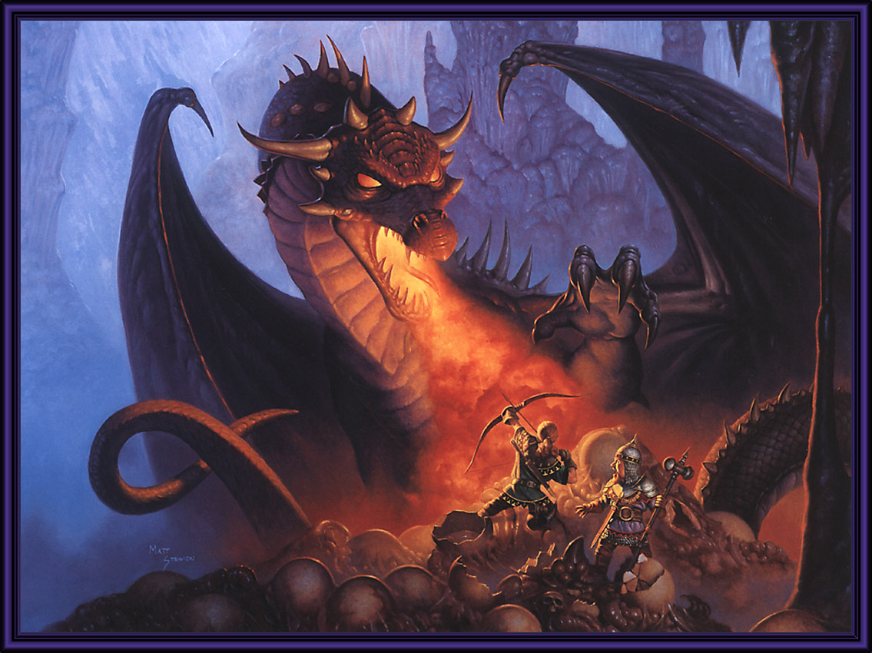
The Beast Attacks (11:7 NLT)
383
"When they complete their testimony, the beast that comes up out of the bottomless pit will declare war against them, and he will conquer them and kill them"

Slide 59
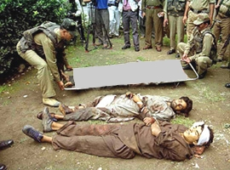
Two Witnesses Killed (11:8-9 NLT)
"And their bodies will lie in the main street of Jerusalem, the city that is figuratively called 'Sodom' and 'Egypt,' the city where their Lord was crucified. ⁹And for three and a half days, all peoples, tribes, languages, and nations will stare at their bodies. No one will be allowed to bury them."

Slide 60


11:8 Great City
330
Revelation 11
Term or Expression | Beale Symbolic | Osborne Symbolic-Literal | Thomas Literal
13 "the great city" (11:8) | "Babylon" = "Rome" = "the ungodly world" | Jerusalem and Rome; secondarily, all cities that oppose God | Jerusalem

Slide 61

11:11-12 Resurrect Two Witnesses
330
Revelation 11
Term or Expression | Beale Symbolic | Osborne Symbolic-Literal | Thomas Literal
14 the resurrec-tion and ascension of the two witnesses (11:11-12) | "divine legitimiza-tion of a prophetic call" | "A proleptic anticipation of the 'rapture' of the church" | the resurrection of the two witnesses

Slide 62

Two Witnesses Ascend (11:11-12 NLT)
383
^{"11}But after three and a half days, God breathed life into them, and they stood up! Terror struck all who were staring at them."
^{"12}Then a loud voice from heaven called to the two prophets, 'Come up here!' And they rose to heaven in a cloud as their enemies watched."

Slide 63

Two Witnesses Taken to Heaven (11:11)

Slide 64
I. Jesus will show God's Word has opposite affects for believers and unbelievers (Rev. 10).
Notes:
"The fact that the angel's face is "as the sun" corresponds to the description of Jesus Christ in Revelation 1:16; his feet correspond to the Lord's description in Revelation 1:15. His voice like a lion suggests Revelation 5:5. This being could well be our Lord Jesus Christ, appearing to John as a kingly angel. Jesus often appeared in the Old Testament as "the Angel of the Lord" (Ex. 3:2; Jud. 2:4; 6:11–12, 21–22; 2 Sam. 24:16). This was a temporary manifestation for a special purpose, not a permanent incarnation.
Two other characteristics would suggest identifying the angel as Jesus Christ: the book in his hand and the awesome posture that he assumed. The little book contains the rest of the prophetic message that John will deliver. Since our Lord was the only One worthy to take the scroll and break the seals (Rev. 5:5ff), it might well be concluded that He is the only One worthy to give His servant the rest of the message.
The angel's posture is that of a conqueror taking possession of his territory. He is claiming the whole world (see Josh. 1:1–3). Of course, only the victorious Savior could make such a claim. The Antichrist will soon complete his conquest and force the whole world to submit to his control. But before that happens, the Savior will claim the world for Himself, the inheritance that His Father promised Him (Ps. 2:6–9). Satan roars like a lion to frighten his prey (1 Peter 5:8), but the Lion of Judah roars to announce victory (see Ps. 95:3–5; Isa. 40:12–17)" (Wiersbe).

Slide 65
II. Two witnesses will show God's protection for believers and wrath for unbelievers (11:1-14).
383

Slide 66

III. Heaven's elders will praise God for his gracious presence (11:15-19).

Slide 67


The 7th Trumpet (11:15-18)
383
"Then the seventh angel blew his trumpet, and there were loud voices shouting in heaven:
'The world has now become the Kingdom of our Lord and of his Christ, and he will reign forever and ever'"
(11:15 NLT)

Slide 68

"The twenty-four elders sitting on their thrones before God fell with their faces to the ground and worshiped him" (11:16 NLT).
¹⁷And they said,
"We give thanks to you,
Lord God, the Almighty,
the one who is
and who always was,
for now you have assumed your great power
and have begun to reign."

Slide 69

¹⁸The nations were filled with wrath, but now the time of your wrath has come. It is time to judge the dead and reward your servants the prophets, as well as your holy people, and all who fear your name, from the least to the greatest. It is time to destroy all who have caused destruction on the earth'" (11:18 NLT)

Slide 70

Heaven's Temple (11:19a)
383
"Then, in heaven, the Temple of God was opened…"

Slide 71

The Ark (11:19b)
383
"…and the Ark of his covenant could be seen inside the Temple…"

Slide 72

Lightning & Hail (11:19c)
383
"Lightning flashed, thunder crashed and roared, and there was an earthquake and a terrible hailstorm."

Slide 73
Three evidences of…

Slide 74

The Main Idea:
Jesus will
protect believers
and judge unbelievers

Slide 75
I. Jesus will show God's Word has opposite affects for believers and unbelievers (Rev. 10).
Notes:
"The fact that the angel's face is "as the sun" corresponds to the description of Jesus Christ in Revelation 1:16; his feet correspond to the Lord's description in Revelation 1:15. His voice like a lion suggests Revelation 5:5. This being could well be our Lord Jesus Christ, appearing to John as a kingly angel. Jesus often appeared in the Old Testament as "the Angel of the Lord" (Ex. 3:2; Jud. 2:4; 6:11–12, 21–22; 2 Sam. 24:16). This was a temporary manifestation for a special purpose, not a permanent incarnation.
Two other characteristics would suggest identifying the angel as Jesus Christ: the book in his hand and the awesome posture that he assumed. The little book contains the rest of the prophetic message that John will deliver. Since our Lord was the only One worthy to take the scroll and break the seals (Rev. 5:5ff), it might well be concluded that He is the only One worthy to give His servant the rest of the message.
The angel's posture is that of a conqueror taking possession of his territory. He is claiming the whole world (see Josh. 1:1–3). Of course, only the victorious Savior could make such a claim. The Antichrist will soon complete his conquest and force the whole world to submit to his control. But before that happens, the Savior will claim the world for Himself, the inheritance that His Father promised Him (Ps. 2:6–9). Satan roars like a lion to frighten his prey (1 Peter 5:8), but the Lion of Judah roars to announce victory (see Ps. 95:3–5; Isa. 40:12–17)" (Wiersbe).

Slide 76
II. Two witnesses will show God's protection for believers and wrath for unbelievers (11:1-14).
383

Slide 77
III. Heaven's elders will praise God for his gracious presence (11:15-19).

Slide 78

Decision Time
Will you choose Christ's grace over his judgment?
Who can you help do the same?

Slide 80
Jesus Wins!
Series on Revelation

Slide 81

NT Sermons link at biblestudydownloads.com
Get this presentation for free!

